Slide 1
Message Payloads
October 13, 2014
Notes:
Guidewire training materials contain Guidewire proprietary information that is subject to confidentiality and non-disclosure agreements. You agree to use the information in this manual solely for the purpose of training to implement Guidewire software solutions. You also agree not to disclose the information in this manual to third parties or copy this manual without prior written consent from Guidewire. Guidewire training may be given only by Guidewire employees or certified Guidewire partners under the appropriate agreement with Guidewire.

Slide 2
Describe the role that message payloads play in messaging
Use Gosu templates to generate message payloads (for any type of text format)
Use XML models to generate message payloads in XML format

Slide 3
Message payloads
Gosu templates
XML models

Slide 4

Message payload
A message payload is data generated in Event Fired rules that is sent to the external system
The payload typically:
Contains dynamically generated data
Is formatted based on the needs of the external system
Event Fired Rules
Destination
Entity Event
message payload
xx_message
EventAware entity
message context
message
Notes:
A message payload contains static and/or dynamically generated data. For example, the payload for bank account message might contain the bank name, routing number, and account number of the given bank account as comma-separated values. The specific values for the bank name, routing number, and account number must be generated dynamically for each bank account message.

Slide 5
Two easy ways for generating payloads
Gosu templates
Create formatted strings with entity data
XML models
Strongly typed XML with XSD validation
Supports object graph
Gosu Template
Event Fired Rules
message payload
message payload
xx_message
message
XML model
Notes:
Gosu template and XML models are not the only ways for generating a message payload, but they are commonly used. Likewise, message payload generation is not purpose of a Gosu template or XML model.
Other features that can be used to generate payloads include:
Manually creating untyped XML using the XmlElement class (as discussed in the "Gosu and XML" lesson)
Manually creating strongly typed XML from an XSD type (as discussed in the "Gosu and XML" lesson)
Gosu string templates (as discussed in the notes in the "Gosu templates" section of this lesson)
Any logic that creates a string suitable for use as a payload.

Slide 6
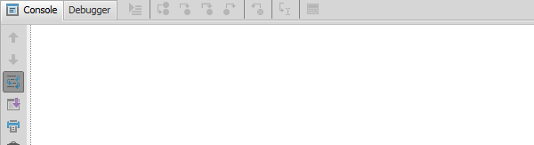
Late binding values
*** Stage 3(a) -- Transforming the message payload with late binding ***
Request plugin: BankAccountVerificationRequest – beforeSend()
Message ID is 630
Replaced token <@@ageOfMessageInSeconds@@> with value 3
Returning payload string
A late binding value is a message payload value that cannot be determined until right before the message is sent (as opposed to when the message is generated)
Use placeholder values (tokens) to add late binding values to the payload during payload generation
Message Request plugin replaces token with the data values immediately before the message is sent
Notes:
Good candidates for late binding include:
A send timestamp
The message ID and/or its public ID
An identifier from the external system that was sent in reply to a previous message
For example, imagine an integration point in which the first message communicates that a new entity was added. The reply to the first message contains the ID to be used for the new entity on the external system. The second message identifies a change on this new entity. However, the second message is created before the first message has been sent (or before the reply to the first message has been received). The second message must use the ID in the reply to the first message. The only way this ID can be added to the second message is through late binding.
Typically, values that are to be late bound are added to the message payload using a placeholder marked by special character delimiters, such as <@@ and @@>. In the message request plugin, these placeholders are replaced with the required data.
Be careful about what data you set via late binding. Typically, the message payload should reflect a consistent snapshot of the system at the time the Event Fired rule executed. Late binding should not be used to capture entity data after message creation.

Slide 7

Errors in message payload generation
Application server(s)
Batch server
triggering and payload generation
sending to external system
xx_message
payload
tran 1
tran 2
tran 3
tran 4
processing acknowledgement
external system
All activity from the triggering event up to the creation of the message itself takes place in the same transaction
If any of this activity, including payload generation, throws an exception, the transaction is rolled back
All work, including the operation that triggered messaging, is undone

Slide 8
Message payloads
Gosu templates
XML models

Slide 9
Gosu template
publicID,ab:68 bankName,FastCash
(publicID) (bankName) ab:68, FastCash
Gosu Template
A Gosu template is a file that generates dynamic, formatted text based on input parameters
Always evaluates to a string
Accepts any number of input parameters
Evaluates parameters and derived values into text
Supports scriptlet syntax for API calls and control of flow

Slide 10
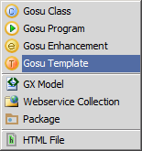
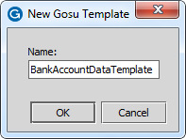
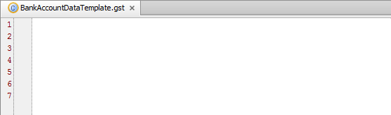
Steps to create a Gosu template
To create a Gosu template:
Right-click the parent package
Select New → Gosu Template
Provide a name for the template
All Gosu template files have a .gst extension

Slide 11
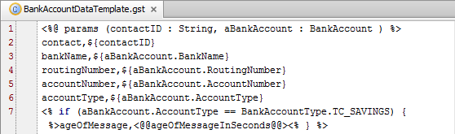
Template syntax: parameters
Input parameter declaration syntax:
<%@ params ( param1 : type, param2 : type, …) %>
Note
White space and line breaks are rendered in the Gosu Templates
Notes:
At the top of the template, create a parameter definition with the following syntax:<%@ params (paramList)%>. Just like a standard Gosu function, it is possible to define one or more parameters. Parameters can be of any type an in the form of “name : type”. Parameters are comma delimited. Later in the template, it is possible to evaluate the parameter objects.
You can use template expression syntax (${ and }) to evaluate parameters. Template expression syntax returns a result and generates additional text. You can use template scriptlet syntax (<% and %>) to evaluate or reference parameters. Scriptlet syntax only executes Gosu statements.
Except for the line that specifies input parameters, any white space in a template is reflected in the template output.

Slide 12
Template syntax: expressions
if contactID is "ab:68", this renders as: contact,ab:68
Template expression syntax
${param1} or <%= param1 %>
Static text is outside of a template expression, template parameter, or template scriptlet
Line 2 → contact, is treated as static text
Notes:
There are two forms of template expression syntax for rendering dynamic text: ${…}, <%=…%>.
${ value to Render } is the preferred syntax. <%= valueToRender %> is an alternative syntax. There is no advantage to using one syntax over the other. For the sake of simplicity, this lesson uses the first syntax exclusively.
Gosu runs your template expression syntax at run time. At compile time, Gosu uses the built-in type checking system to ensure the embedded expression is valid and type safe. For instance, if the expression does not return a value of type String, Gosu attempts to coerce the result to the type String.
You can also use template expression syntax to embed a Gosu expression in String literals (as opposed to having the template text stored in a separate .gst file). This can be useful if there is a relatively short but complex dynamic string that needs to be generated in a method or business rule where having the template in a separate file is less practical. For example, if an Event Fired rule needs to send only a public ID and the number of evaluations, then it might be preferable to write the Event Fired rule like this:
msg = messageContext.createMessage( publicID,${anABcontact.PublicID}\nNumOfEvals,${anABcontact.VendorEvaluations.length})

Slide 13
Template syntax: scriptlet
Evaluate scriptlet syntax
<% if (something=true) { %> … <% } %>
Text within <% and %> evaluated as Gosu at run-time
Conditional logic, variable assignments, loops, etc.
Scope is across scriptlet tags
Notes:
Text enclosed within <% and %> evaluate as Gosu at run-time and are referred to as scriptlet tags. Unlike the alternative expression syntax, there is no equals sign in the opening tag.
The parser evaluates the scriptlet tags in the order that the appear. Scriptlet tags do not generate template output. All plain text between scriptlet tags generates output within the scope and the logic of the scriptlet code. Use this feature to write advanced logic that uses Gosu code that you spread across multiple scriptlet tags. The scope of the Gosu continues across scriptlet tags.
In the sample code, you can observe how the sricptlet functions to add an extra name-value pair to the output when the BankAccount AccountType equals savings.
Acme has a business requirement which states that, when verifying savings accounts, the age of the message must be submitted. Because the age of the message cannot be determined when the message is created, the Gosu template adds a placeholder for late binding: <@@ageOfMessageInSeconds@@>. The name-value pair conveys to the external system the age of the message, but only for savings accounts.
The Sending Messages lesson discusses late binding in more detail.

Slide 14
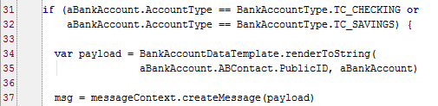
Rendering a Gosu template
Syntax var resultString = template.renderToString(paramList)
Gosu Template is considered first-class object
Notes:
The template is a first-class object in the Gosu type system within its package namespace. Technically, templates are not instantiated as objects. To run a template, reference your template and call the static renderToString() method of the template, and if required, pass any required parameters.
If you first reference a template in a “uses” statement, as in the example above, you do not need to use a fully qualified name later on. Otherwise, the template must be referenced using a fully qualified name, e.g., acme.ta.messaging.bank.BankAccountDataTemplate.

Slide 15
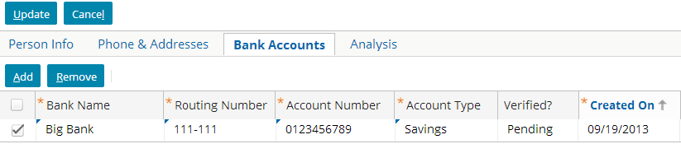
Gosu template payload example
Event Fired Rules
The Request Plugin transformed the payload
Sending payload to console for Message ID 630 as:
contact,ab:5
bankName,Big Bank
routingNumber,111-111
accountNumber,0123456789
accountType,savings
Gosu Template
message payload
message
Notes:
The example above shows the triggering entity in the user interface for a bank account for William Andy whose public ID is ab:5.
The Event Fired Rules determine that the message payload requires an Gosu Template because the Account Type is Checking or Savings

Slide 16
Message payloads
Gosu templates
XML models

Slide 17

XML model
<ABContact> <PublicID>ab:68 </PublicID> </ABContact>
ABContact 68
XML model
An XML model is a file that generates dynamic XML based on an input object
Accepts a single input object and can specify
XML-formatted values from that object
XML-formatted values from related objects
Notes:
The diagram above represents the input and output for an XML model. The input is a single entity, and the output is XML with values from the entity or entities related to it.
There are several benefits to using a Guidewire XML model including the following:
No need to manually create XML
Reduces potential for error
Easy to change XSD when requirements change
Publishes XSD under a URL
Definitions are formalized
Concrete artifact produced beyond documentation
Allows for parallel development with same understanding
Object model created from your definitions
Can be used at runtime to automatically generate a message payload
Optionally generate only if entity fields have changed
Maps Gosu data entities, Gosu classes, and Java classes

Slide 18
XML model base types
Each model has a base type, which determines:
The type of object you must pass to the model
The data you can include in the model
Entity (data model)
Related entities
Properties
Virtual
Database backed
Gosu Class
Properties
Java Class
Properties
Seen as getProperty() method

Slide 19
XML model fields
A key property
Defines a unique identifier for an entity represented in the XML
If keyed object is exported, so is key
Use to maintain parent-child relationships
A normal property
By default exported when containing instance is exported – this behavior can be changed
NULL values not exported by default
Entity fields can be omitted from model
Not defined in XSD nor exported to XML
Mapping a sub-object field causes sub-object to appear as nested element in XML
Notes:
A key property field defines a unique identifier for an entity represented in the XML. A key field is always included in the generated XML, if any field of the corresponding entity is exported. This differs from normal fields, which may not be exported if null or unchanged. Key fields are typically used to maintain parent/child relationships of Guidewire entities as represented in the exported XML.
A normal property field is a field that may be included in the XML when exporting an instance of that type. By default, normal fields export for elements having null values. By default, normal fields export for both changed and unchanged elements (where "changed" is from the perspective of an open transaction).

Slide 20
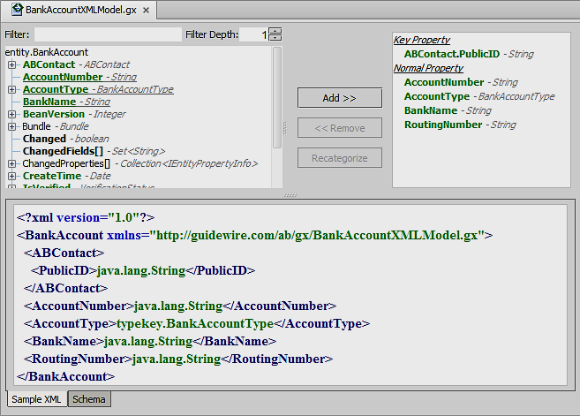
XML model editor
XML Model editor creates GX Models
File extension is .gx
Steps to create
Create GX model
Add fields to the model
Use the model to generate the message payload
Fields to add based on entity
Fields added to Model
Sample XML or Schema

Slide 21
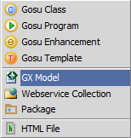
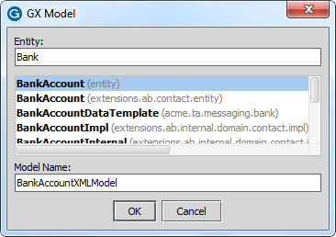
Step 1: Create the model
To create a GX Model:
Right-click the parent package
Select New → GX Model
Specify the Entity
Specify a model name
Entity determines model’s filter
Default naming is:
<entity>Model
Notes:
It is common for the list to include multiple types with identical names but different packages (namespaces). Be sure to choose the correct type in the list during this step.
Initially, the model has no fields in it.

Slide 22
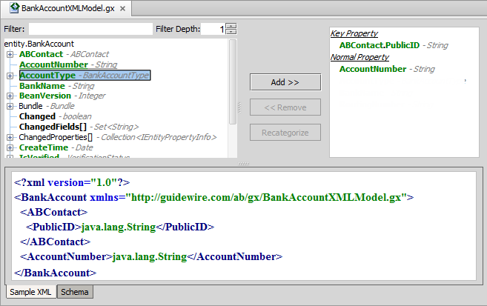

Step 2: Add fields
Click Add
Select field
Select property type
Notes:
Only bolded fields can be added to the model including black and green. Typically, unbolded fields represent complex types (such as entities) that cannot be added, but that have subfields that can be added. Green fields are database-backed fields. Black fields are virtual fields. Underlined fields have already been added.
To add a field to the model:
Click the field in the left pane.
Click the "Add >>" button and select either "Key Property" or "Normal Property".
The field is added to the list of the fields in the right pane and appears in the sample XML in the bottom pane.
You can also re-categorize a field (from Key to Normal or vice versa) or remove it.
To re-categorize a field, select it in the right pane, click the Recategorize menu button, and select the new category.
To remove a field, select it in the right pane and click the "<< Remove" button.
Fields are listed in alphabetic order.

Slide 23
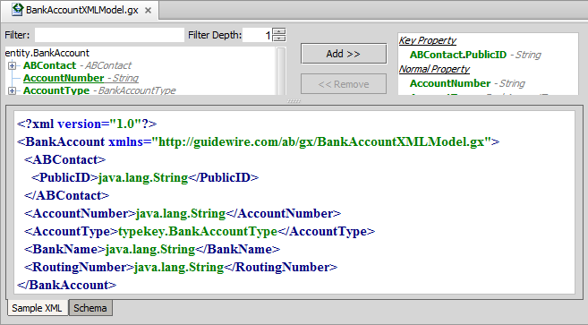
The model's XML
Sample XML bottom tab shows generated model
Use model anytime XML must be generated
Message Payload, web service data, XMLtoJSON
Notes:
The namespace starts with "http://guidewire.com/gx..." and is fixed. The remaining part of the namespace is often the fully qualified name of the model.
You can also view the model's XSD from the schema tab. For the model shown above, the first part of the XSD has been included below:
<?xml version="1.0"?>
<xsd:schema xmlns:xsd=http://www.w3.org/2001/XMLSchema xmlns:gw=http://guidewire.com/xsd xmlns="http://guidewire.com/gx/trainingapp.base.bank.BankAccountXMLModel"
targetNamespace=http://guidewire.com/gx/trainingapp.base.bank.BankAccountXMLModel elementFormDefault="qualified">
<xsd:element name="BankAccount" type="BankAccount" nillable="true"/>
<xsd:complexType name="BankAccount">
<xsd:sequence>
<xsd:element name="ABContact" minOccurs="0">
<xsd:complexType>
<xsd:sequence>
<xsd:element name="PublicID" minOccurs="0" nillable="true" type="xsd:string" gw:type="java.lang.String"/>

Slide 24
Step 3: Use the model to generate payload
Syntax:
var xml = new modelName.modelType(param1) var payload = messageContext.createMessage( xml.asUTFString())
modelName
must be fully qualified
modelType
Type for model: Entity, Gosu, Java)
asUTFString()
Generate the XML with UTF encoding
Notes:
An XML model can format its output as a UTF string or as bytes. In most cases, a UTF string is appropriate. There may be some situations where bytes is preferable, but this is an issue that is complex, implementation-dependent, and beyond the scope of this course. For more information on whether a given XML model should format its output as bytes, consult with your Guidewire technical representative.

Slide 25
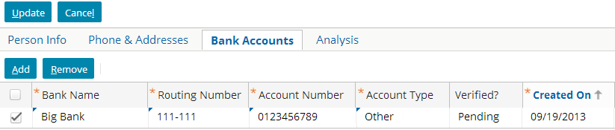
XML Model payload example
Event Fired Rules
<?xml version="1.0"?> …
<BankAccount xmlns="…bankaccountxmlmodel"> <ABContact>
<PublicID>ab:5</PublicID>
</ABContact>
<AccountNumber>0123456789</AccountNumber>
<AccountType>other</AccountType>
<BankName>Big Bank</BankName>
<RoutingNumber>111-111</RoutingNumber>
</BankAccount>
XML model
message payload
message
Notes:
The example above shows the triggering entity in the user interface for a bank account for William Andy whose public ID is ab:5.
The Event Fired Rules determine that the message payload requires an XML model because the Account Type is Other. Checking and savings accounts have their payload generated via a Gosu template.

Slide 26
Additional XML model functionality
Every model has its own XSD
You can view it on the model's Schema tab
Guidewire applications publish the XSDs for use by external applications
Every model has properties specific to XML models
ShouldSend - has at least one (normal) field in the model changed?
HasExceptions - were any exceptions thrown while generating the XML?
Every model's constructor can be used to:
Export only those properties that have changed
Export properties, even if their value is null
Suppress exceptions thrown during XML construction
Notes:
For more information about XML model functionality, refer to the Gosu Reference.
Automatic Publishing of the Generated XSD
When the Guidewire application is running, the application publishes the XSD at the following URL: http://<hostname>:<port>/<appCode>/ws/<slashSeparatedPackagePathToModel>/<ModelName>.gx. For example, the bank account XML model is named "BankAccountXMLModel" and it is stored in the acme.ta.messaging.bank package. Therefore, the URL to access the model's XSD is:
http://localhost:8880/ab/ws/acme/ta/messaging/bank/BankAccountXMLModel.gx
Other applications can import this XSD and validate any generated XML against this XSD.
Model-Specific Properties
Although $ShouldSend is often associated with using a model in Incremental mode, the behavior of $ShouldSend does not change based on the value of the Verbose option or the Incremental option. Also note that $ShouldSend can be evaluated only if all properties in the model are data-backed; inclusion of any virtual properties (any black in the model editor) in the model will cause $ShouldSend to always be false.
When Gosu checks for mapped data model properties that changed, Gosu checks both normal or key properties. Generally speaking, since a key property is supposed to uniquely identify an object, it should never change.
See the Gosu Reference for further information on model methods.
(continued)

Slide 27
Notes:
Customizing Guidewire Model XML Output (GXOptions)
Every XML model has a default one-argument constructor, which is the object on which the model is based. You can use an alternate constructor to add additional options that change XML export behavior. The alternate constructor takes an additional argument of type GXOptions, which stands for Guidewire XML model options. A GXOptions object has these Boolean properties:
Incremental - For normal properties backed by database columns, export properties only if they change. The default is false.
Verbose - Export an XML element for a property even if the value for that property is null. The default is false.
SuppressExceptions - Suppresses exceptions that occur in the process of getting values from objects. Exceptions can occur because some properties are actually backed either by Gosu enhancement property get functions, or internal Java code (virtual properties). The default is false.

Slide 28
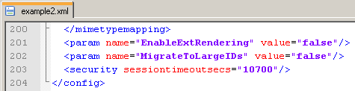
Additional XML functionality
7 var security = new XmlElement(new QName( "http://guidewire.com/config", "security"))
8 security.setAttributeValue("sessiontimeoutsecs", "10700")
9 xml.addChild(security)
10 var outputFile = "C:/example2.xml"
11 var output = new BufferedWriter(new FileWriter( new File(outputFile)))
12 output.write(xml.asUTFString())
13 output.close()
14 print ("XML file written")
Gosu contains an XmlElement class that can be used to manually manipulate XML
Use to when the external system needs XML formatted in a special way
Notes:
You can store an XSD inside a Guidewire application directory. During startup, the application reads the XSD and converts it into a Gosu type. Code can then create XML using the "preloaded" XSD type.
For more information on using the XmlElement class in Gosu to read in, manipulate, and/or write out XML, refer to the "Gosu and XML" lesson.

Slide 29
Deploy message payload code
Restart Server
Reload PCF
GX (XML) Model
Gosu Template
reload the application metadata
ALT+SHIFT+L
XML model
Gosu Template
Notes:
You must restart the server when you create or modify XML Models. You need to only Reload PCFs when you create or modify Gosu Templates.

Slide 30
Describe the role that message payloads play in messaging
Use Gosu templates to generate message payloads (for any type of text format)
Use XML models to generate message payloads in XML format

Slide 31
Identify if each statement describes a Gosu template, an XML model, both, or neither.
It can take any number of input values.
It is a separate file created in Studio.
It has a published XSD.
It can make use of conditional statements and for loops.
It can include values from both the object that triggered the message event and objects related to the triggering object.
It can be used only for payload generation
Notes:
Answers
1. Gosu templates. (XML models always have a single input, which is the object upon which to base the XML to be generated.)
2. Both.
3. XML models.
4. Gosu templates.
5. Both. (Gosu templates can do this either by having the related objects passed to it or by having the triggering object passed to it and using its foreign keys to navigate to the related objects. XML models can do this by including fields from the related objects in the XML model.)
6. Neither. (Both Gosu templates and XML models can be used anywhere strings or XML need to be generated, including classes, rules, plugins, web services, and batch processes.)

